Slide 1
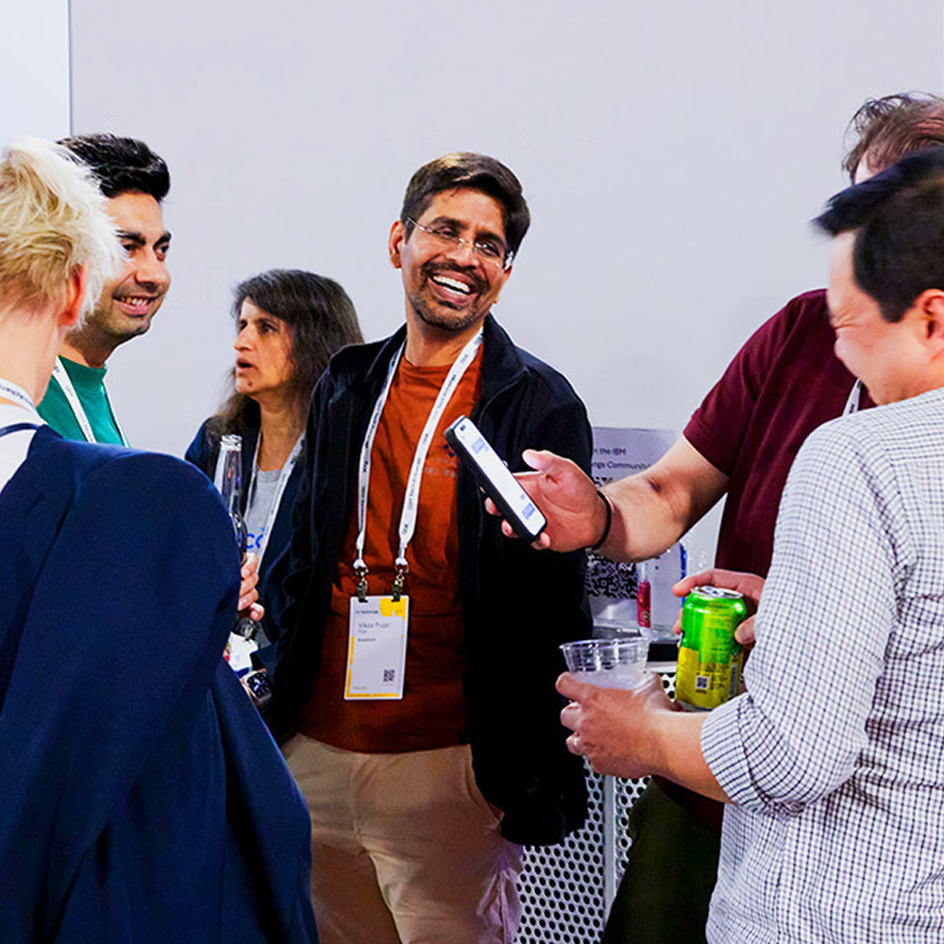
IBM TechXchange 2026 conference
Instructor-led Lab Presentation
Template & Guidance
#IBMTechXchange

Slide 2
Instructor-led Lab introductory presentation template guidance
This short presentation is to be used to introduce your instructor-led lab. Please ensure that your presentation is uploaded in PowerPoint format only and submitted in the Speaker Portal.
Please include the following information on your title slide:​
Session code (ID number)​
Session title​
Speaker name
Speaker company​
When naming your file, use this standard naming convention: Session 4-digit code followed by a space followed by the name of the session.
Example: “1436 My Session”
Review the Presentation guidance on pages 3 – 12 to get started.
Use Master Pages to ensure consistency throughout your presentation.
These are sample slides that you may use and customize. Remember to delete all instructional text (in blue) before finalizing your slides.
Please note:​
All sessions must include the Notices and Disclaimers slide (slide 30) at the end of your presentation
Do not include performance data or competitive claims in your presentations​
We encourage you to use the digital version rather than printing your slides
For questions, reach out to speakerhelp@ibm.com.

Slide 3
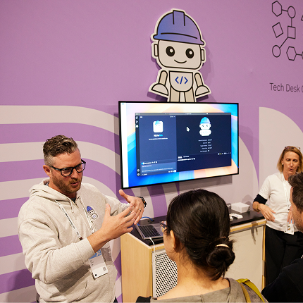
Practice & tips
While creating content for your session, think about your audience and what they would care about.
Introduce yourselves and provide an overview of your lab.
Ensure your lab environment is ready prior to your presentation.
Track your rehearsal time and compare it with your session duration. We recommend keeping your intros short – no longer than 10 minutes.
Arrive 15 mins prior to your scheduled lab to ensure you’re properly set up.
Take advantage of Speaker Coaching resources on the Speaker Portal for tips on how to deliver a great intro!

Slide 4

Instructor-led
Lab Session (2257):
Introduction
From Streams to Insights:
Building Real-Time Data Pipelines with Confluent and watsonx.data
Marco Sesay
Technical Specialist, IBM

Slide 5




Instructor-led Lab Guide Team
Kavitha Paranthaman
Brand Technical Specialist (Data)
—
Kavitha.Paranthaman@ibm.com
309.826.5181
Marco Sesay
Brand Technical Specialist (Data)
—
marco.sesay@ibm.com
443.625.8697
Shalini Maripadaga
Confluent Solutions Engineer
—
smaripadaga@ibm.com

Slide 6
What you will learn
01
How to connect a live streaming pipeline to watsonx.data
How to enrich and join streaming data with enterprise datasets
How to keep streaming data governed and query-ready at scale
02
03

Slide 7
How to get to your Instructor-led Lab environment
Open a fresh Chrome browser
Chrome home page will default to the TechZone lab URL (per room)
Sign in with IBMid used to register for event
Accept TechZone Terms & Conditions
*Only displays if user has never signed into TechZone prior
Login to lab page with access code provided by instructor
Open lab guide & access environment to perform lab

Slide 8
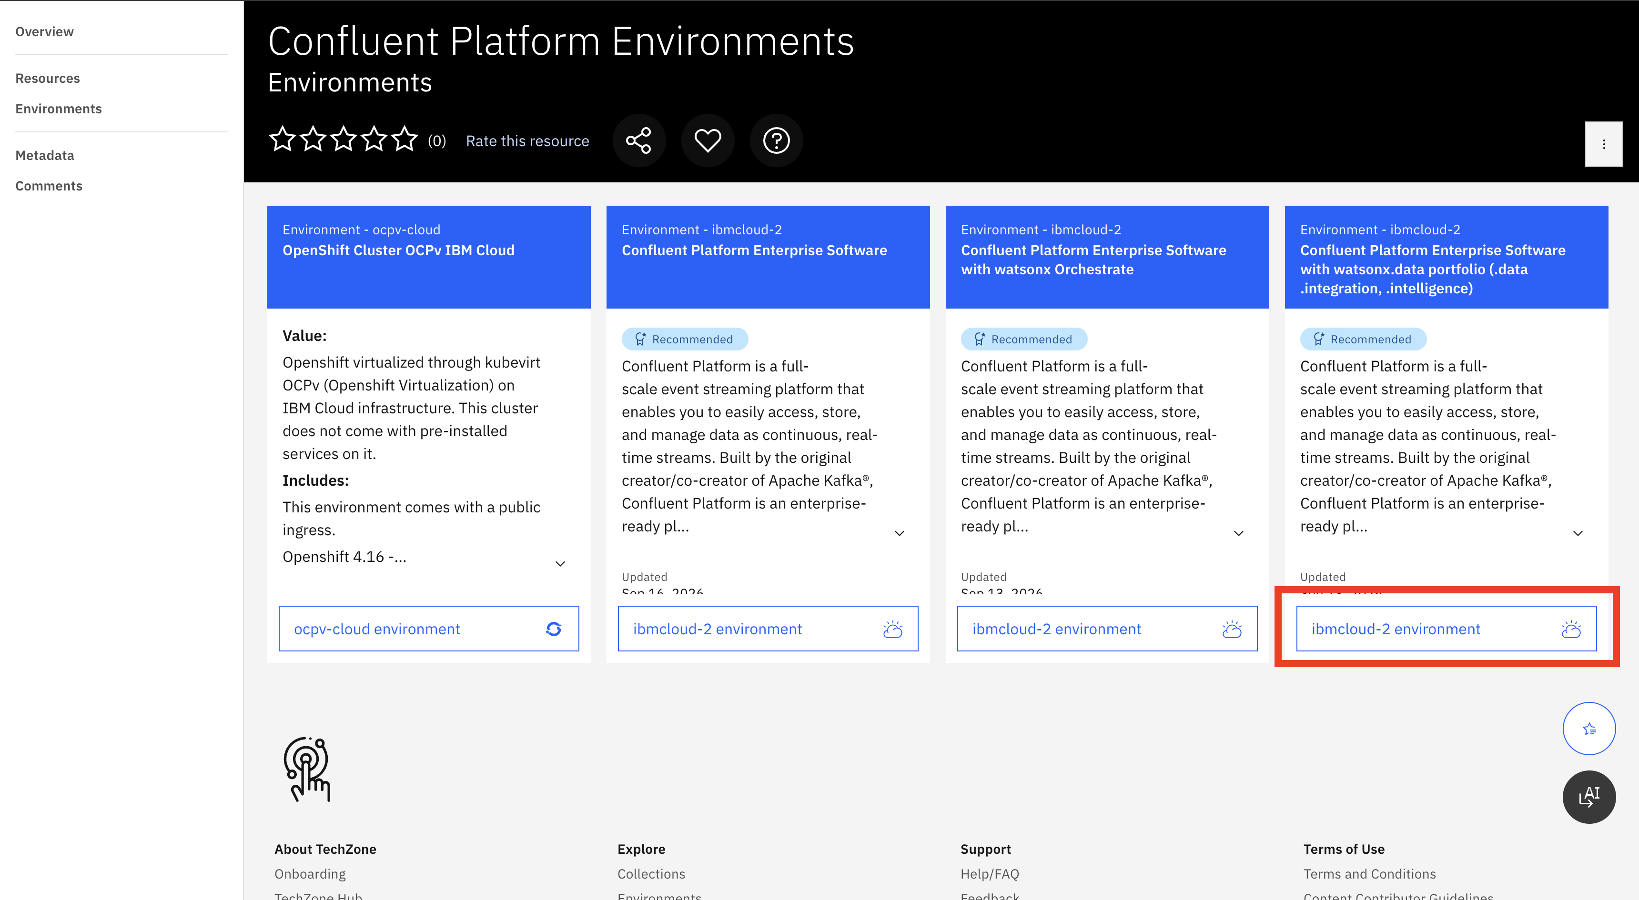
Provisioning an Environment - Selection
https://techzone.ibm.com/collection/69fb856b6b914691e9ee83c1/environments?platform=6a74b63b374bd3b283e71305
1

Slide 9
Notices and disclaimers
© 2026 IBM Corporation. All rights reserved.
This document is distributed "as is" without any warranty, either express or implied. In no event shall IBM be liable for any damage arising from the use of this information, including but not limited to, loss of data, business interruption, loss of profit or loss of opportunity.
Examples presented are illustrative only. Actual results will vary based on client configurations and conditions and, therefore, generally expected results cannot be provided.
Workshops, sessions, and associated materials may have been prepared by independent session speakers and do not necessarily reflect the views of IBM.
Not all offerings are available in every country in which IBM operates.
Statements regarding IBM's future direction, intent, or product plans are subject to change or withdrawal without notice, and represent goals and objectives only.
IBM, the IBM logo, and ibm.com are trademarks or registered trademarks of IBM Corporation, in in the U.S. and/or other countries Other product and service names might be trademarks of IBM or other companies. A current list of IBM trademarks is available on ibm.com/trademark.
Certain comments made in this presentation may be characterized as forward looking under the Private Securities Litigation Reform Act of 1995.
Forward-looking statements are based on a company's current assumptions regarding future business and financial performance. Those statements by their nature address matters that are uncertain to different degrees and involve a number of factors that could cause actual results to differ materially. Additional information concerning these factors is contained in the Company's filings with the SEC. Copies are available from the SEC, from the IBM website, or from IBM Investor Relations.
Any forward-looking statement made during this presentation speaks only as of the date on which it is made. The Company assumes no obligation to update or revise any forward-looking statements except as required by law; these charts and the associated remarks and comments are integrally related and are intended to be presented and understood together.
IBM TechXchange | © 2026 IBM Corporation

Slide 10
Thank you
Marco Sesay
Technical Specialist, IBM
marco.sesay@ibm.com

